Slide 1

To Do List Project
Adam Stevenson

Slide 2
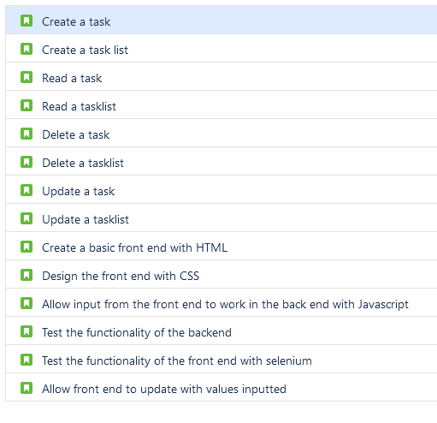

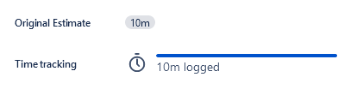




Jira

Slide 3
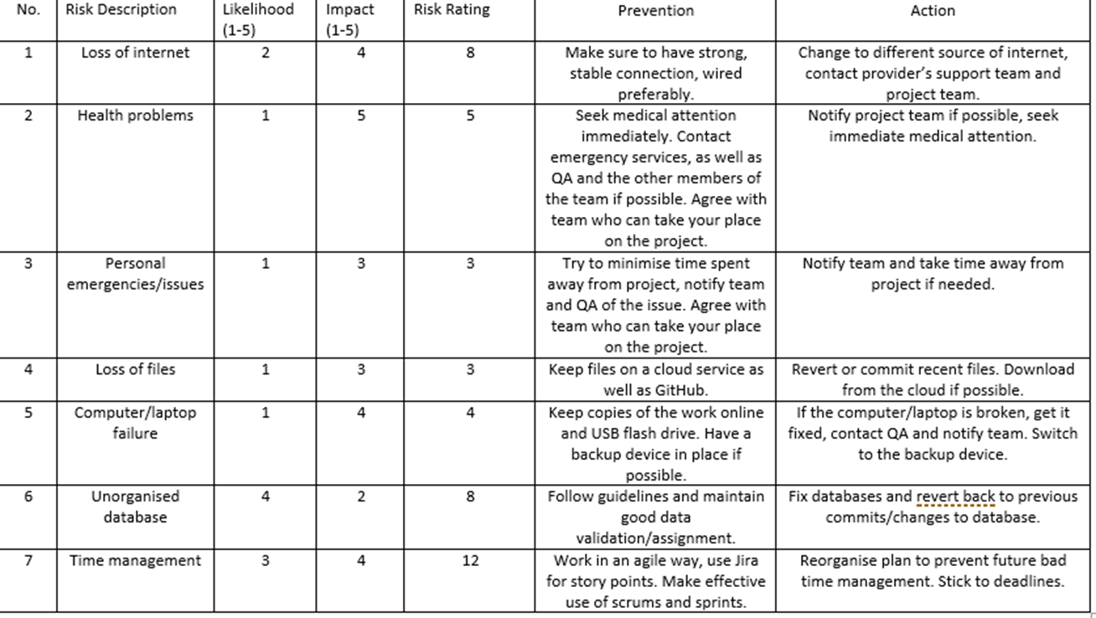
Risk Register

Slide 4
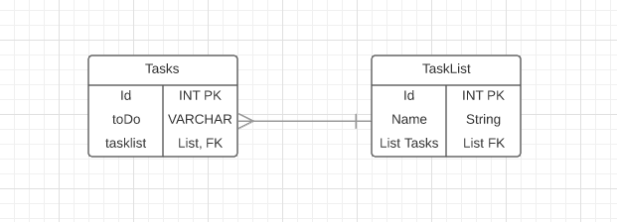
Entity Relationship Diagram

Slide 5
Problems I faced
Time constraints: We were given a lot less time to work on this project than previously thought and so I had to plan better to make sure I knew everything that could be done.
Making sure the most impactful parts of the project were completed.
Difficulty working with JavaScript as it’s a new concept to me so I asked for help when needed!

Slide 6
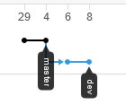
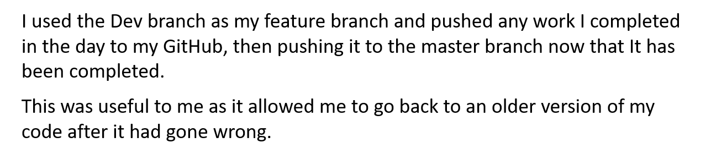
Feature Branch Model

Slide 7
My To Do List!!

Slide 8
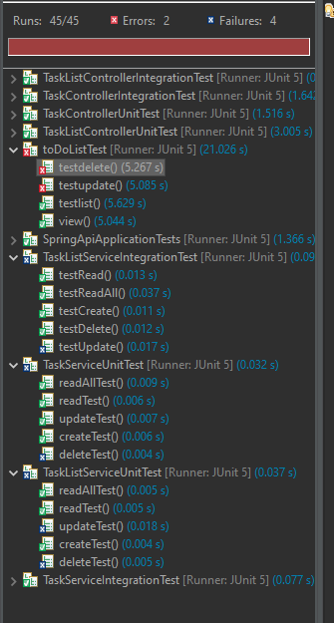
Junit and Mockito Testing

Slide 9
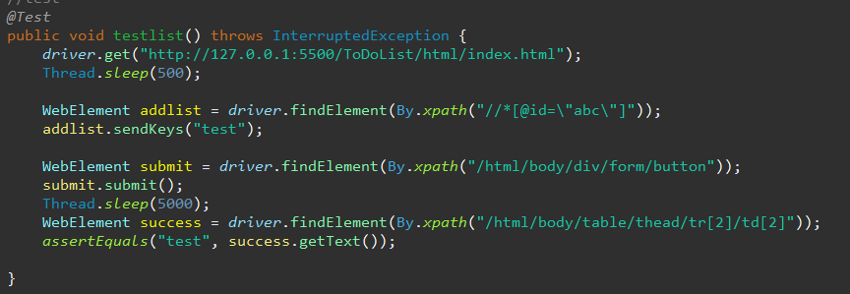
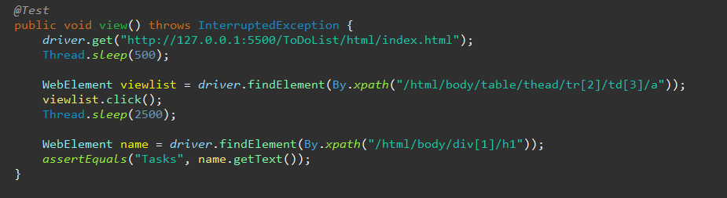
Selenium Tests

Slide 10
Any Questions?

